Slide 1
Applied Physics(C. Sc.) BS CS Semester-I Course Code: L-2(Force, mass and weight) IUB & All Affiliated Colleges. Reality Awards Boost Up (YT-Channel)
Rushmat Ali
Assistant Professor OF Physics
Govt. Kh. F. Graduate College R. Y. Khan

Slide 2
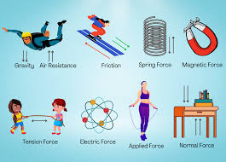
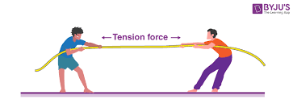
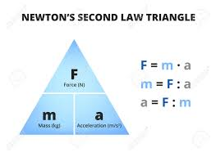
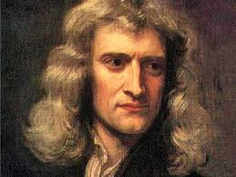
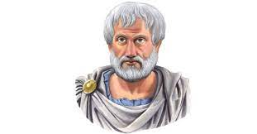
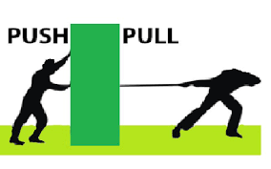
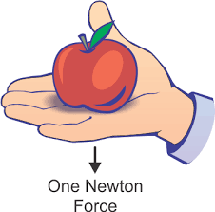
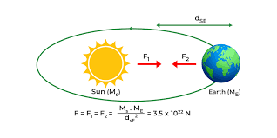

Force:
Force is an external agent capable of changing a body’s state of rest or motion. It has a magnitude and a direction. The direction towards which the force is applied is applied.
Force is a physical cause that changes or may tend to change the state of rest/motion of object. It also changes the shape of the object.
By Newton’s IInd law of motion: $\vec{F }=m \vec{a }$. The S.I. unit of force is Newton. 1 N=(1 kg) (1 m/s2). The C.G.S unit is dynes: 1 dyne =(1 gm)(1cm/s2). Dimension:[F]=[ML$T^{−2}]$
Sir Isaac Newton was born especially tiny but grew into a massive intellect and still looms large, thanks to his findings on gravity, light, motion, mathematics, and more.
Aristotle famously represented a force as anything that causes an object to undergo “unnatural motion”.
Force Characteristics:
It is a produced due to interaction between two objects.
It may change the state and direction of motion.
It can also alter the direction of a moving object.
It is a vector quantity, which means it has both magnitude and direction.

Slide 3
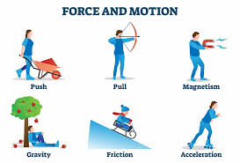
What are the Effects of Force?
In physics, motion is defined as the change in position with respect to time.
In simpler words, motion refers to the movement of a body. Typically, motion can either be described as:
Change in speed
Change in direction
The Force has different effects:
Force can make a body that is at rest to move.
It can stop a moving body or slow it down.
It can accelerate the speed of a moving body.
It can also change the direction of a moving body along with its shape and size.

Slide 4
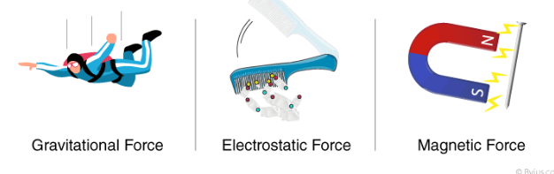
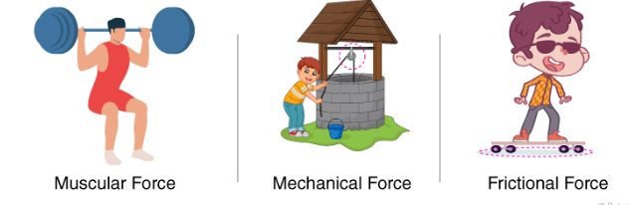
Types of forces:
Force is a physical cause that can change an object’s state of motion or dimensions.
There are two types of forces based on their applications:
Contact Force:
Forces that act on a body either directly or through a medium are called contact forces.
Examples of contact forces are: Muscular Force, Mechanical Force, Frictional Force.
The muscular force of animals like bullocks, horses, and camels to get the activities done. The frictional force acts between a pair of a surface in contact and tends to oppose the motion of one surface over the other.
2) Non-Contact Force:
Forces that act through spaces without making direct contact with the body are called non-contact forces.
Examples of non-contact forces are: Gravitational Force, Electrostatic Force, Magnetic Force
Magnetic force and electrostatic force act on an object from a distance. The weight of a body is the force that is pulled by the earth towards the centre.

Slide 5
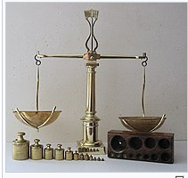
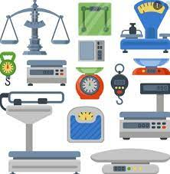
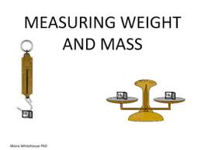
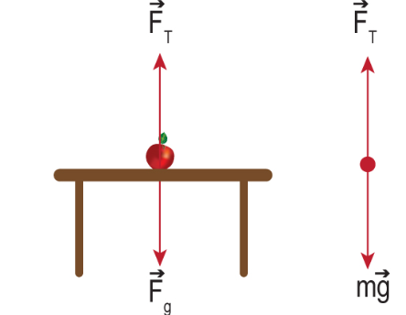
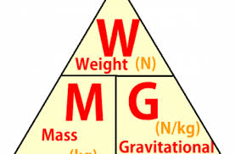
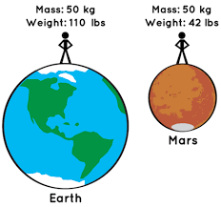
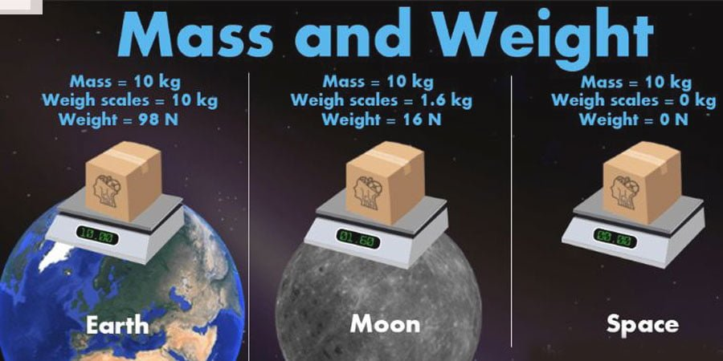
Difference b/w Mass and Weight
Mass
Mass is a measure of how much element something comprises.
Mass is constant but not changeable.
Mass is the same everywhere.
If we consider an object which mass is 2kg on the earth.
In the orbital, this object’s mass is the same as before (2kg).
It is measured by physical balance.
It is denoted by m.
S.I. Unit is kg.
Its dimension: [M]
Its formula: m=F/a
Weight
Weight is a measure of how happy gravity is pulled.
The weight is fully depending on gravity.
Weight is changeable.
A small particle weight is 2 N on the earth but in the orbit, this particle’s weight is 0 N due to gravity.
Weight is directly related to the amount of force which acts in an object due to the gravity.
Gravitational force is not the same everywhere so that the weight of an object is not the same everywhere
Weight is denoted by W
S.I. Unit: N=kg m/s2
Dimension of weight: [MLT−2]
Derivation of weight: W=mg

Slide 6
Similarities between mass and weight
Weight is a measure of how much gravity is pulled and mass is a measure of how much element something comprises. So there is a similarity between mass and weight in the measurement issue.
If an object mass is heavy it has more inertia and larger the weight it has more inertia too. So, Mass and weight are similar on the basis of inertia.
If gravity is constant, weight and mass are the same.
W = mg
→ W = m ( 1)
→W = m

Slide 7
Problems Force
Q.1) How much net force is required to accelerate a 1000 kg car at 4.00 m/s2?
Solution: Given, a = 4.00 m/s2 m = 1000 kg
Formula: F = ma = 1000 × 4 F= 4000 N
Q.2) Aimee has a toy car mass of 2 kg. How much force should she apply to the car so that it should travel with the acceleration of 8 m/s2?
Solution: Known, m (Mass of toy car) = 2 Kg, a (Acceleration) = 8m/s2,
F is Force to be applied by Aimmee F = m × a
= 2 Kg × 8 m/s2 = 16 Kgm/s2 = 16 N.
Q.3) A hammer having a mass of 1 kg going with a speed of 6 m/s hits a wall and comes to rest in 0.1 sec. Compute the obstacle force that makes the hammer stop.
Solution: Given, => Mass of Hammer, m = 1 kg, Initial Velocity, u = 6 m/s,
Final Velocity, v = 0 m/s, Time Taken, t = 0.1 s
The acceleration is: a = (v – u)/t Therefore, a = -60 m/s2 [-ve sign indicates retardation]
Thus, the retarding Force, F = ma = 1 × 60 = 60 N
The End

